Slide 1





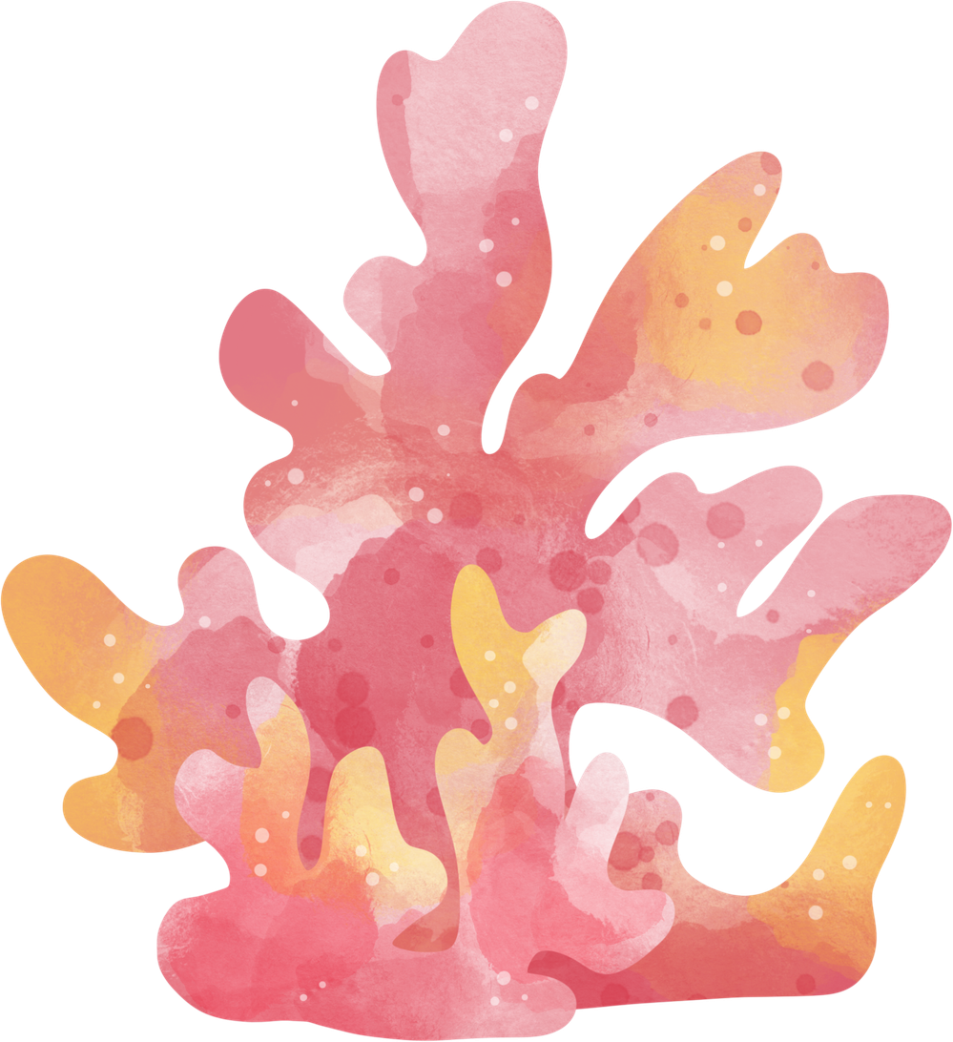

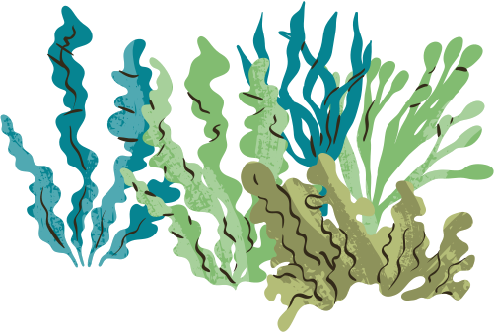

Presented By Larana Inc.
Ocean
Knowledge
Start Now

Slide 2

Ocean Size
Coverage
The ocean covers about 71% of the Earth's surface and plays a key role in climate regulation.
Ocean Depth
The deepest ocean areas can reach around 11,000 meters below sea level.
Coverage
The ocean covers about 71% of the Earth's surface and plays a key role in climate regulation.
Next

Slide 3
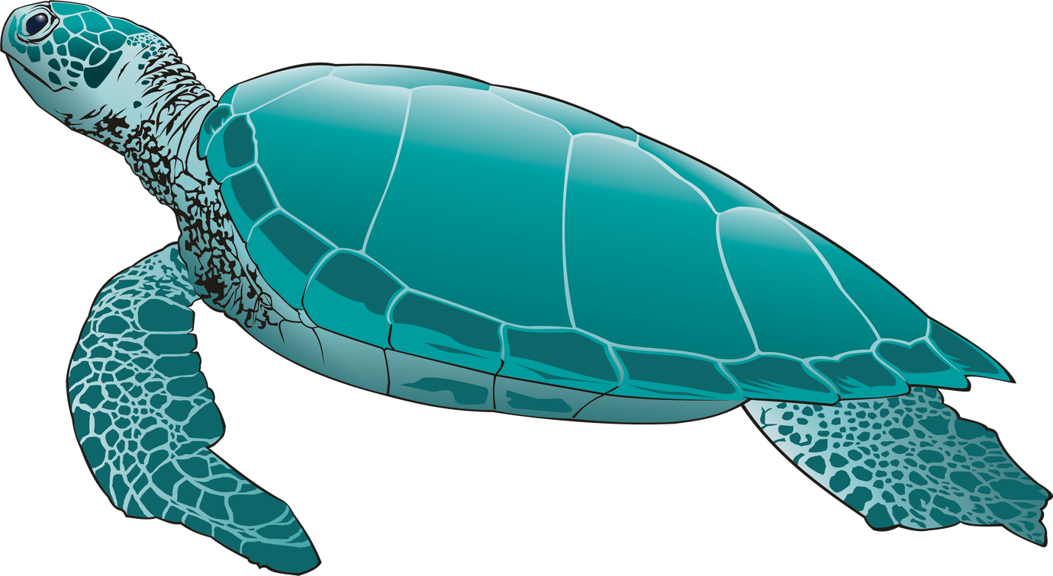
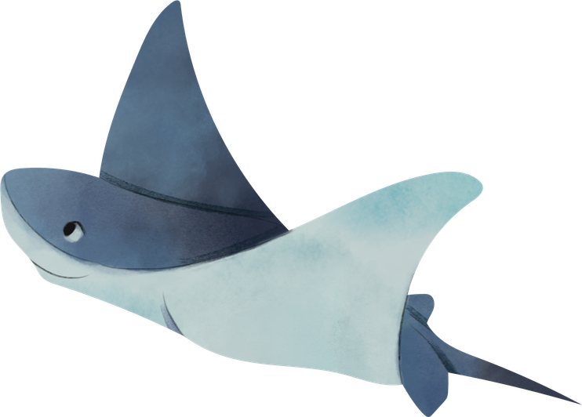

Ocean Zones
Surface Life
This upper layer extends to about 200 meters and supports most marine plants.
Dim Light
Between 200 and 1,000 meters, sunlight becomes weak and fewer organisms live here.
Next

Slide 4
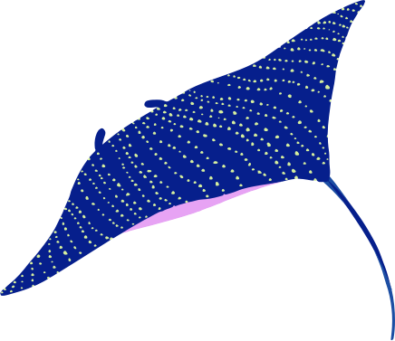

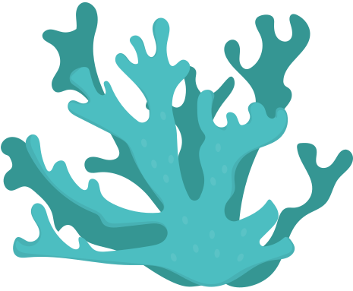
Marine Life
Species Diversity
The ocean may contain around 2 million species, many still undiscovered.
Fish Population
Coral Reefs
About 3 billion people depend on fish for food.
Coral reefs support nearly 25% of marine species.
Next

Slide 5
Presented By Larana Inc.
Thank
You
Last Page

